Slide 1
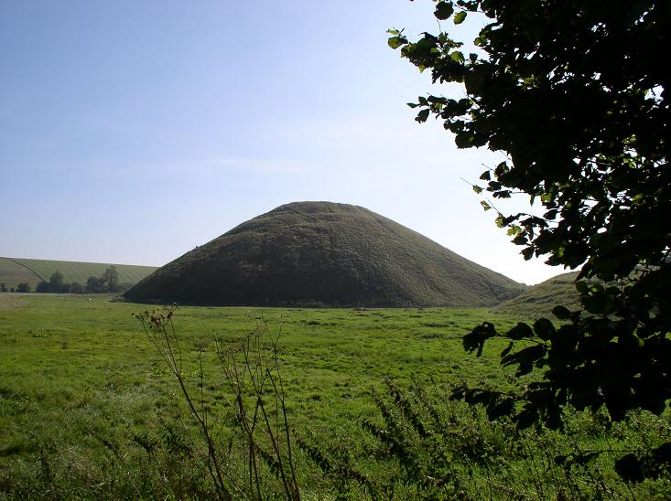
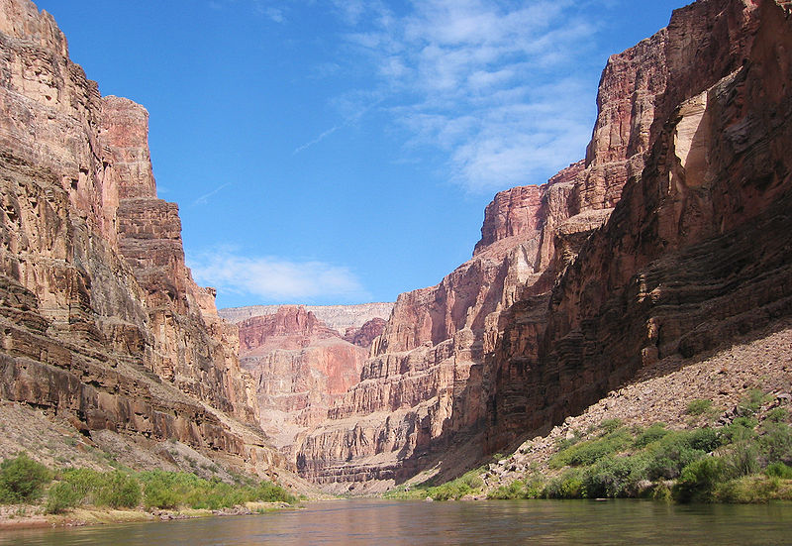
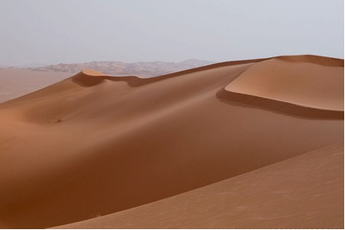
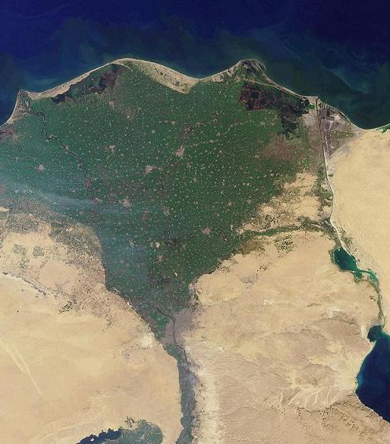
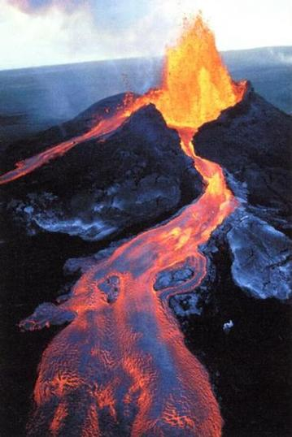
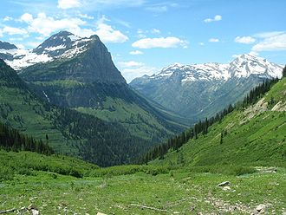
NAME THAT LANDFORM!!!!!!

Slide 2
What landform am I?

Slide 3
Canyon

Slide 4
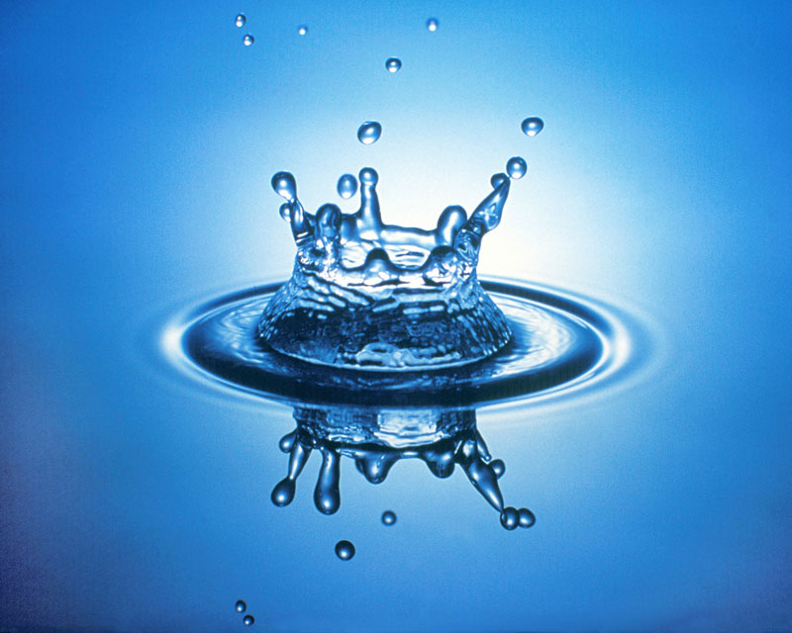
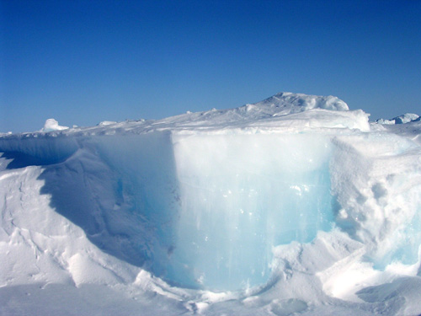
Which agent(s) changed me?
Water
Wind
Ice

Slide 5
A canyon is changed by water.

Slide 6
Which process occurred?
Weathering
Erosion
Deposition
Was it a slow or fast change?

Slide 7
A canyon is changed by water and the
process of erosion (slow change).

Slide 8
What landform am I?

Slide 9
Sand dune

Slide 10
Which agent(s) changed me?
Water
Wind
Ice

Slide 11
A sand dune is changed by wind.

Slide 12
Which process occurred?
Weathering
Erosion
Deposition
Was it a slow or fast change?

Slide 13
A sand dune is changed by wind and the process of deposition (slow change).

Slide 14
What landform am I?

Slide 15
Valley

Slide 16
Which agent(s) changed me?
Water
Wind
Ice

Slide 17
A valley is changed by ice.

Slide 18
Which process occurred?
Weathering
Erosion
Deposition
Was it a slow or fast change?

Slide 19
A valley is changed by ice and the process of weathering and erosion (slow change).

Slide 20
What landform am I?
River’s mouth

Slide 21
Delta
River’s mouth

Slide 22
Which agent(s) changed me?
Water
Wind
Ice

Slide 23
A delta is changed by water.
River’s mouth

Slide 24
Which process occurred?
Weathering
Erosion
Deposition
Was it a slow or fast change?

Slide 25
A delta is changed by water and the process of deposition.
River’s mouth

Slide 26
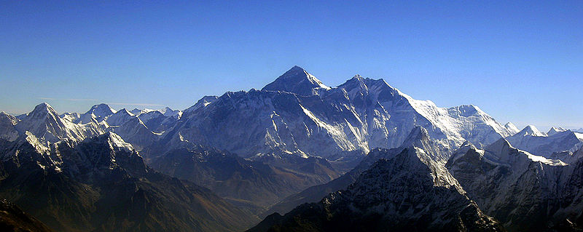
What landform am I?

Slide 27
Mountain

Slide 28
Which agent(s) changed me?
Water
Wind
Ice

Slide 29
A mountain is changed by water, wind and ice.

Slide 30
Which process occurred?
Weathering
Erosion
Deposition
Was it a slow or fast change?

Slide 31
A mountain is changed by water, wind and ice through the process of weathering and erosion (slow change).

Slide 32
What landform am I?

Slide 33
Volcano

Slide 34
Which agent(s) changed me?
Water
Wind
Ice

Slide 35
A volcano is changed water, wind and ice.

Slide 36
Which process occurred?
Weathering
Erosion
Deposition
Was it a slow or fast change?

Slide 37
A volcano is changed by water, wind and ice through the process of weathering erosion and deposition (slow and fast change).

Slide 38
What landform am I?

Slide 39
Hill

Slide 40
Which agent(s) changed me?
Water
Wind
Ice

Slide 41
A hill is changed by water, wind and ice.

Slide 42
Which process occurred?
Weathering
Erosion
Deposition
Was it a slow or fast change?

Slide 43
A hill is changed by water, wind and ice through the process of deposition.

